Slide 1


Partners of the Outaouais Region
Transition from School to Active Life (TEVA)
Resource Pages
Image generated by Canva
When and with Whom Should you Partner?
The school team
The school team, the youth and their family
The youth and their family
A few years before finishing high school
The final year of high school
Starting their life beyond high school
The TEVA process begins at school and its success depends on collaboration with families and community partners to build a strong and coordinated support network.
School administrators are responsible for initiating the TEVA process as part of the student's individualized education plan and should begin early enough to allow sufficient time for meaningful planning and the implementation of essential supports.
Working together with the student, family, and support team, information is gathered across key areas of life. Goals, actions, and transition supports are then identified and coordinated with the appropriate partners to help the student move toward a successful transition to adult life.
TEVA regional committee in the Outaouais – November 2025

Slide 2
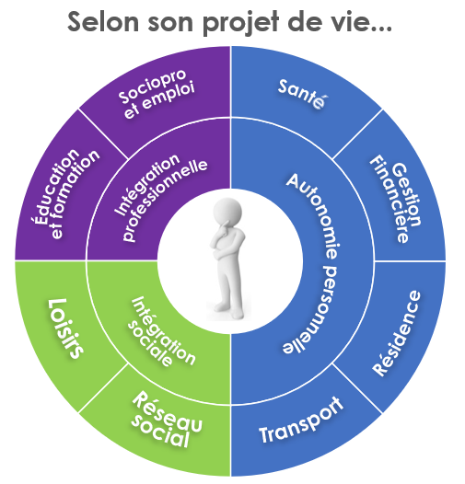
Transition from School to Active Life (TEVA)
Resource Pages
Various partners to support a wide range of needs
Each partner organization of the TEVA regional committee in the Outaouais is presented in this tool via a resource page linked to the area of life that the organization can support.
To make it easier to search for information that aligns with the young person’s needs and life plan, the resource pages have been grouped into three (3) sections.
Blue Section
Support for the development of personal autonomy
Purple Section
Support for professional integration
L’équipe-école
L'équipe-école, le jeune et sa famille
Green Section
Support for social integration
TEVA Regional Committee in the Outaouais - November 2025

Slide 3
Transition From School to Active Life (TEVA)
Resource Pages
Supporting the development of personal autonomy
Health
Steps to take to promote self-management of one’s health: nutrition, stress management, exercise routines, healthcare, etc., ...
Financial Management
Steps to take to build financial independence: create a budget, track expenses, save money, …
Housing
Steps to take to become more independent in terms of housing: searching for housing, home maintenance, support network, etc., …
Transport
Steps to take to promote independence in transportation: options for transportation and route options, safety, etc., …
L’équipe-école
Résidence
Transport
Click here to access the section on supporting the development of independence.
TEVA Regional Committee in the Outaouais - November 2025

Slide 4
Transition from High School to Active Life (TEVA)
Resource Pages
Supporting professional Integration
Education and training
Steps to take to ensure educational success, acquire the necessary tools to realize one’s potential, and prepare for a career.
Socio-professional Integration
Actions to be taken to integrate into or continued participation in the labor market.
L’équipe-école
L'équipe-école, le jeune et sa famille
Click here to access the section of supporting professional integration.
TEVA Regional Committee in the Outaouais - November 2025

Slide 5
Transition from High School to Active Life (TEVA)
Resource Pages
Supporting Social Integration
Leisure
Steps to take to explore interests and promoting a healthy work-life balance.
Social
Steps to consider for building healthy, lasting relationships: networking, community activities, social events, etc., …
L’équipe-école
Click here to access the supporting social integration section.
TEVA Regional Committee in the Outaouais - November 2025

